Slide 1
ER Diagrm
Conceptual Design

Slide 2
Designing a Database
Requirement Gathering
Conceptual Design → Conceptual Model
Entity Relationship Diagram (ERD)
Logical Design → Logical Model
Relational Schema
Physical Design → Physical Model
Actual implementation on a DBMS
Indexes
Views
Normalize or de-Normalize
Security
Access rights
Notes:
Physical design is the time when you abbreviate the names that you chose during logical design. For example, you can abbreviate the column name that identifies employees, EMPLOYEE_NUMBER, to EMPNO.

Slide 3
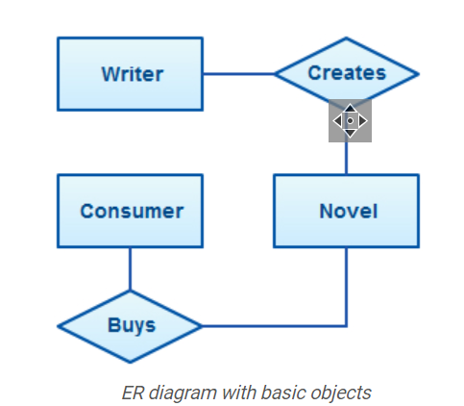
Conceptual design
Pictorial Form / Flow chart
Made for client
Easy to understand
Inexpensive to change

Slide 4
We will start with Conceptual design

Slide 5
ER diagram
An entity relationship diagram (ERD) shows the relationships of entity sets stored in a database.
ER diagrams are used to sketch out the design of a database.

Slide 6
ER Concepts
Entity (Nouns in the text )
Attributes (Properties of the Entity)
Relationship (Verb, relationship between the entities)
Example:
A student ‘Ali’ with id ‘1100’ takes a course of ‘Database Systems’.

Slide 7
Entity representation in ER Diagram (Rectangle)
Student
Course

Slide 8
Strong Entity vs Weak Entity
An entity is strong if it can independently exist
An entity is weak when its existence depends on another entity.

Slide 9
Example of weak entity
Child can't exist without parent
Section can't exist without class
Account can't exist without bank
Representation
Section

Slide 10
Attributes representation in ERD (Oval)
id
Properties of an entity
Student
name

Slide 11
Types of an attribute
Types of attributes
Key attribute
Composite attribute
Derived attribute
Simple attribute
Multivalued attribute

Slide 12

Attributes
Month
date
DOB
Age
year
CGPA
Hobby
Student
Roll No
Notes:
Age needs to be updated after every year separately for every individual. So we keep it derived.

Slide 13
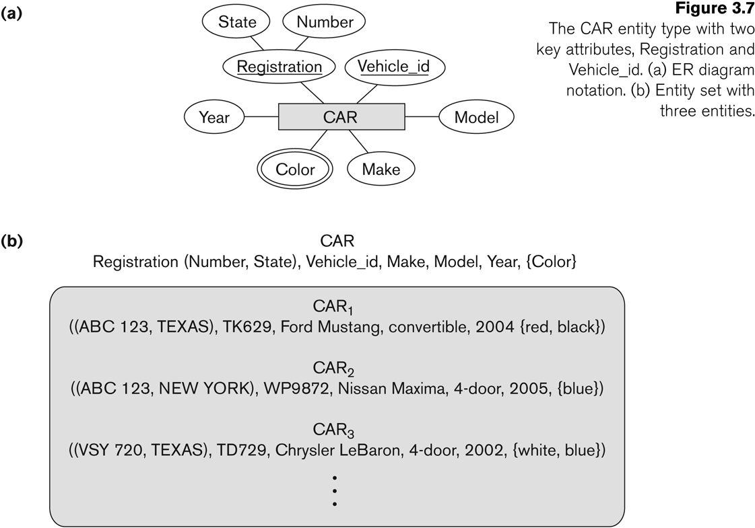
Types of keys

Slide 14
Relationship representation in ERD (Diamond)
Please note: Readability is Left to Right & Top to bottom
Student
Enrolls in
Course
Is taught by
Teacher

Slide 15
Wrong structure
Please note: Readability is Left to Right & Top to bottom
Correct it.
Teacher
Is taught by
Course
Enrolls
Student

Slide 16
Constraints on Relationship
Cardinality
Participation
One to many (1:N)
One to one (1:1)
Many to many (M:N)
Total Participation
Partial participation

Slide 17
Relationship: cardinality
1 : M
M : N
1 : 1
Faculty
Works for
Department
Faculty
Teaches
Courses
Faculty
Is head of
Department

Slide 18
Relationship: cardinality
1 : M
M : N
1 : 1
Works for
1
Faculty
M
Department
Teaches
M
Faculty
N
Courses
1
1
Faculty
Is head of
Department

Slide 19
Relationship: Particitaion
Total or partial
Faculty
works
Department
Faculty
Teaches
Courses
Faculty
Is head of
Department

Slide 20
Relationship: cardinality and Participation
1 : M
M : N
1 : 1
works
1
Faculty
M
Department
M
N
Faculty
Teaches
Courses
Is head of
1
Faculty
1
Department

Slide 21
Attributes of relationship
A relationship can have attributes:
For example, grade of enrolls
Its value for each relationship instance describes the grade a student takes when he is enrolled in a course.
A value of Grade depends on a particular (Student, Course) combination
Students
Enrolls
Course
Grade

Slide 22
Recursive Relationship: Rolenames
Employee is supervisor of other employees
Employee
supervisee
Supervisor
is supervisor of
1
M

Slide 23
Identifying relationship
Relationship between a strong and weak entity is identifying.
Why it would be needed?
Employee
has
Dependent
have
Medical Reports

Slide 24
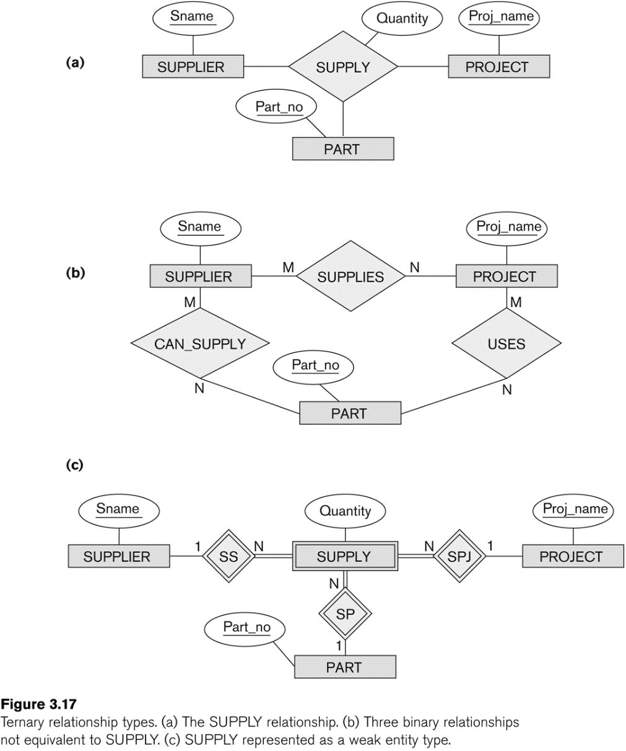
Ternary relationship

Slide 25
Activity: Design an ERD
The company is organized into departments. Each department has a unique name, a unique number, and a particular employee who manages the department. We keep track of the start date when that employee began managing the department. A department may have several locations.
A department controls a number of projects, each of which has a unique name, a unique number, and a single location.
We store each employee’s name, Social Security number,2 address, salary, gender , and birth date. An employee is assigned to one department, but may work on several projects, which are not necessarily controlled by the same department. We keep track of the current number of hours per week that an employee works on each project. We also keep track of the direct supervisor of each employee (who is another employee).
We want to keep track of the dependents of each employee for insurance purposes. We keep each dependent’s first name, gender, birth date, and relationship to the employee.

Slide 26
Mention cardinality & participation Identify Weak entities Identify relationship attributes
The company is organized into departments. Each department has a unique name, a unique number, and a particular employee who manages the department. We keep track of the start date when that employee began managing the department. A department may have several locations.
A department controls a number of projects, each of which has a unique name, a unique number, and a single location.
We store each employee’s name, Social Security number,2 address, salary, gender , and birth date. An employee is assigned to one department, but may work on several projects, which are not necessarily controlled by the same department. We keep track of the current number of hours per week that an employee works on each project. We also keep track of the direct supervisor of each employee (who is another employee).
We want to keep track of the dependents of each employee for insurance purposes. We keep each dependent’s first name, gender, birth date, and relationship to the employee.

